Slide 2

Image to Cartoon using GAN
Lê Hoàng Anh– 20224297
Vũ Minh Hiển - 20224311

Slide 3
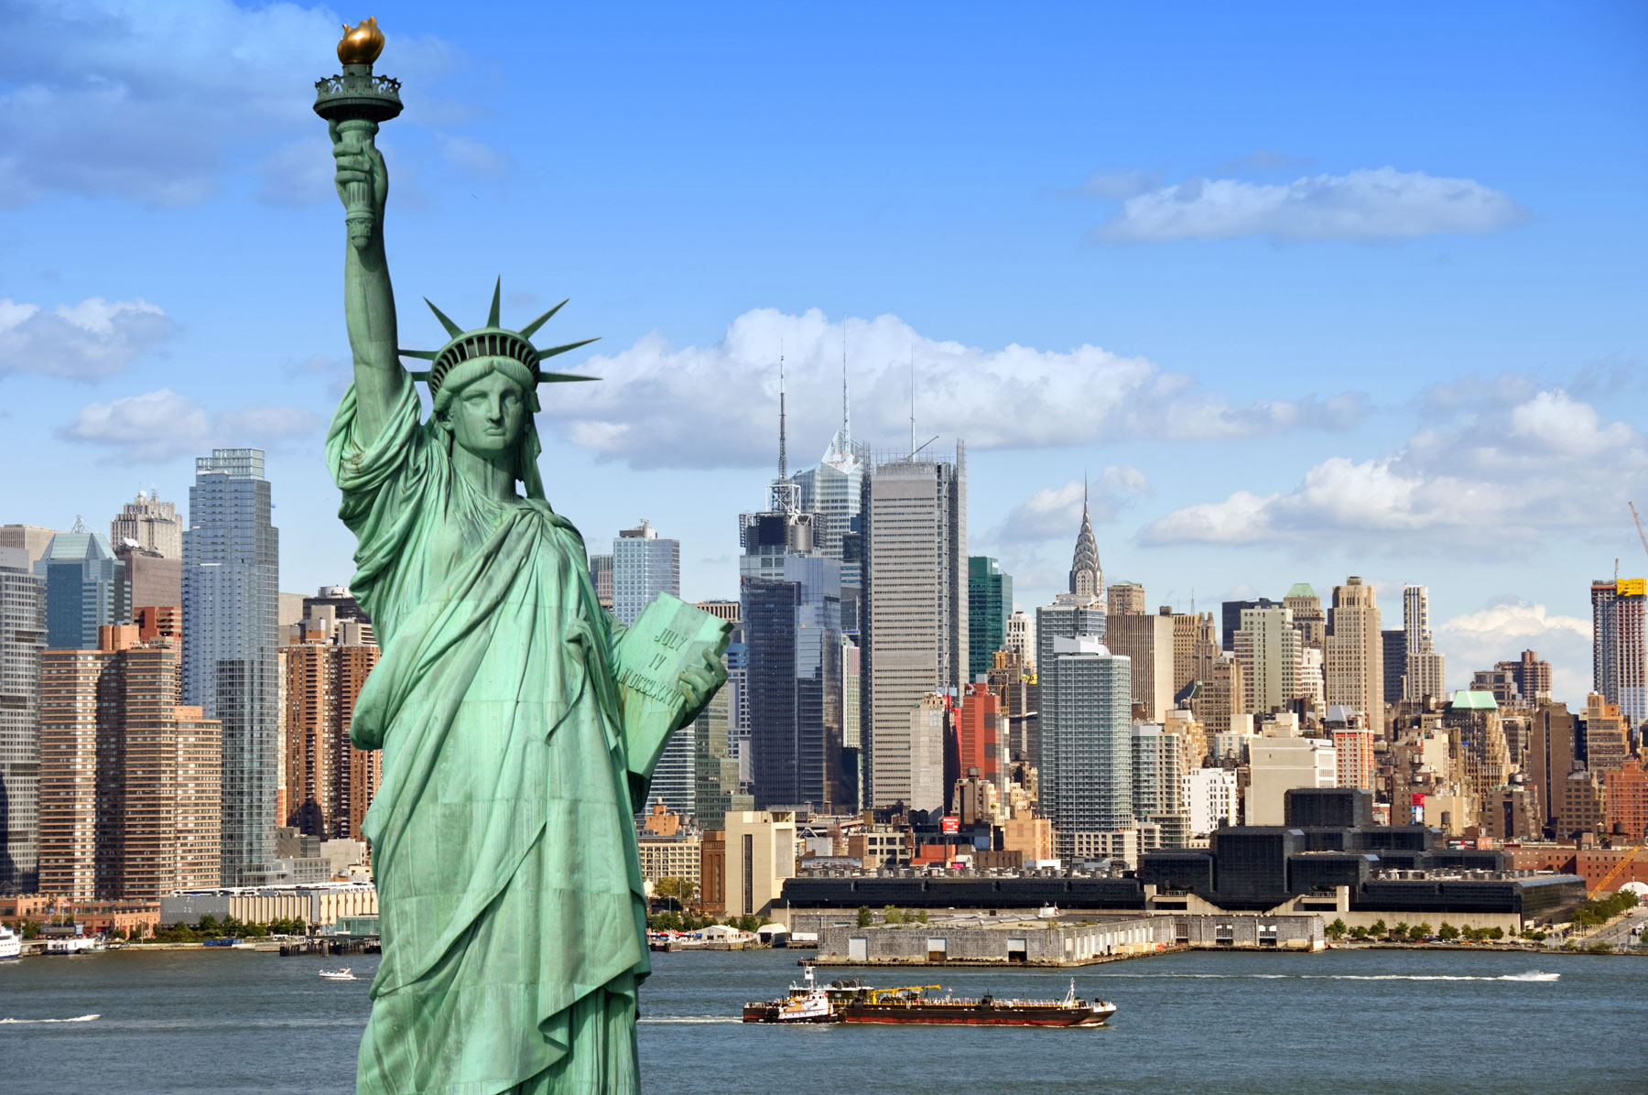
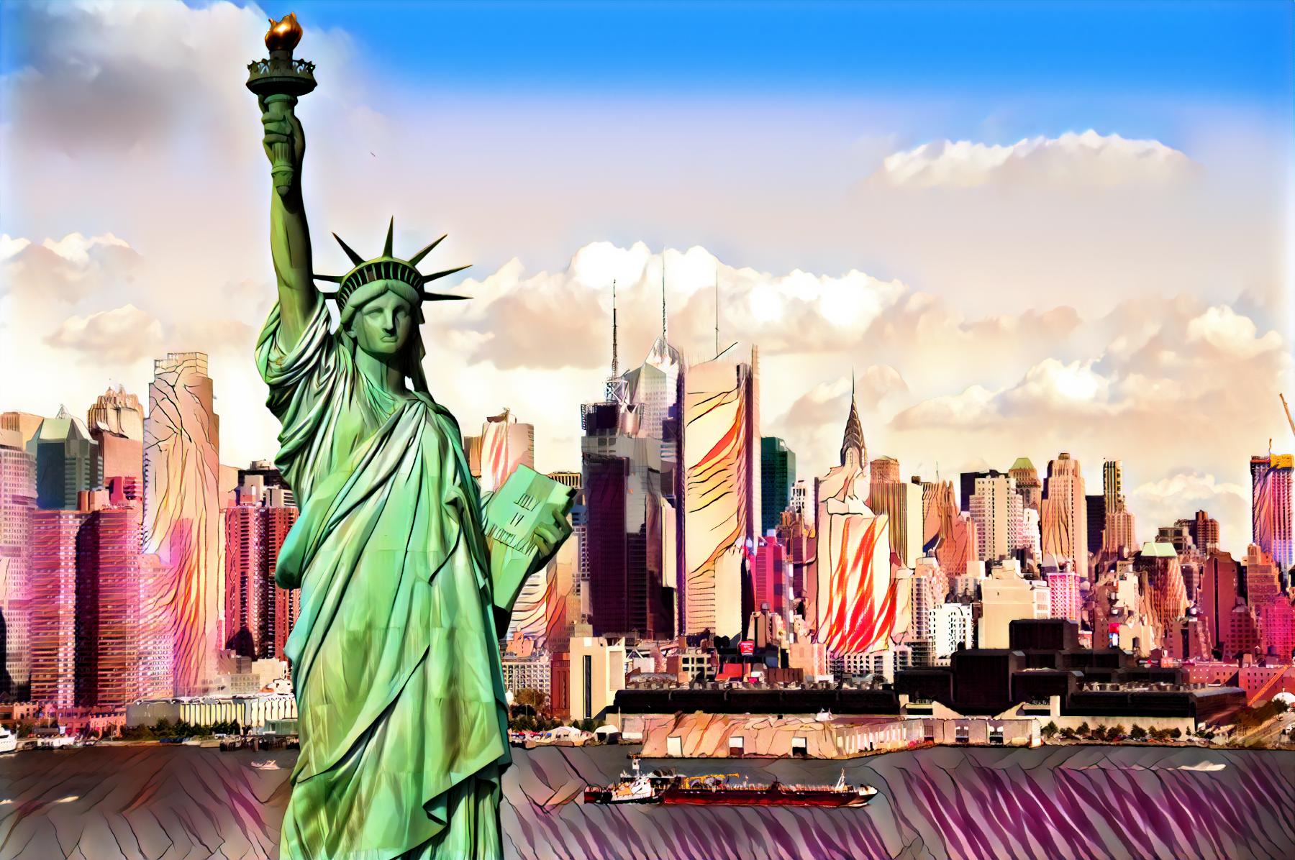
INTRODUCTION
Figure1: Input and Output
Notes:
First I get 40 images which collected at VNUF on August 24th, 2024 for my 3D reprenstation

Slide 4
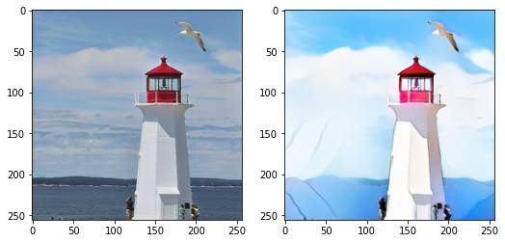
INTRODUCE
1. Statement:. Transform real-world photos into high-quality cartoon-style images with the following characteristics:
High-level abstraction.
Clear edges.
Smooth color shading and simple textures
2. Challenges:
Significant differences between real photos and cartoon styles.
Existing methods fail to capture the unique features of cartoonization.
Notes:
Here is a briefly description about Dataset

Slide 5
INTRODUCE
3. Proposed Solution:
CartoonGAN ( Generative Adversarial Network): A GAN-based framework specifically designed for cartoon stylization.
Training Data: Utilizes unpaired real photos and cartoon images for training.
4. Key Contributions:
Semantic Content Loss: Implements sparse regularization on high-level feature maps of the VGG network to preserve content despite substantial style differences.
Edge-Promoting Adversarial Loss: Enhances the reproduction of clear edges, a key characteristic of cartoon images.
Initialization Phase: Improves network convergence and training efficiency.
Notes:
Here is a briefly description about Dataset

Slide 6
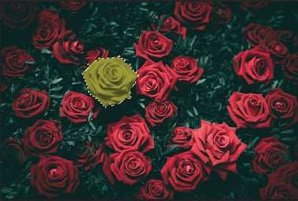
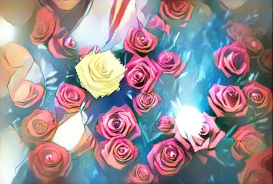
INTRODUCE
5. Results:
Generates high-quality cartoon images with clear edges and smooth shading, aligning with specific artists' styles.
Outperforms state-of-the-art methods in cartoon stylization.
Notes:
Here is a briefly description about Dataset

Slide 7
IMPLEMENTATION
2.2 Generator Network (G):
Purpose: Maps real-world photos to the cartoon manifold to produce stylized images
Architecture:
Flat Convolution Stage
Down-Convolution Blocks
Residual Blocks
Up-Convolution Blocks

Slide 8
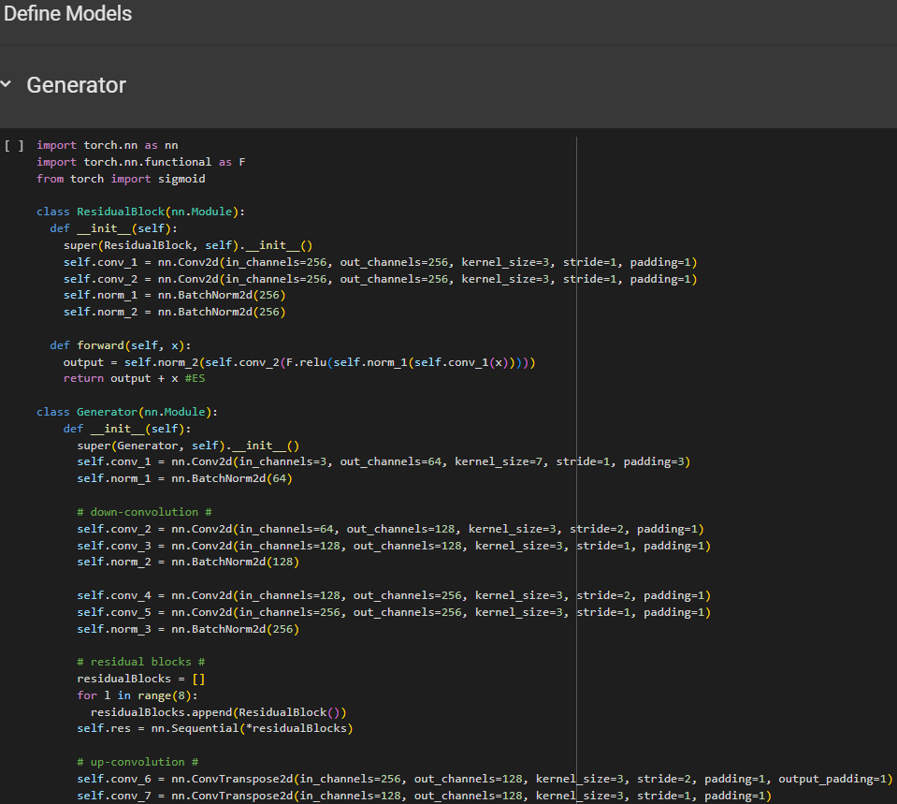
IMPLEMENTATION
2.2 Generator Network (G):

Slide 9
IMPLEMENTATION
2.3 Discriminator Network (D):
Purpose: Judges whether an input image is a real cartoon image.
Architecture:
Patch-level Discriminator:.
Network Structure:
Flat Layers Stage:
Strided Convolution Blocks:
Feature Construction Block 3x3 Convolutional Layer

Slide 10
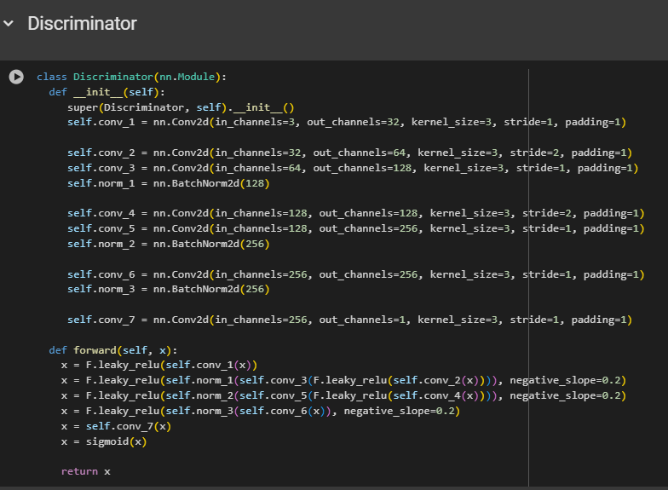
IMPLEMENTATION
2.3 Discriminator Network (D):

Slide 11
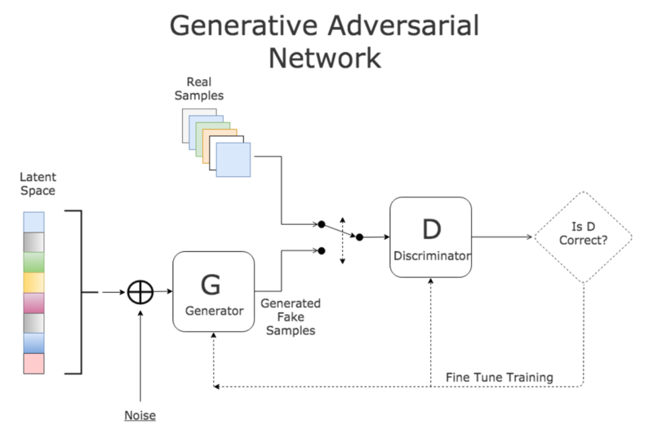
IMPLEMENTATION

Slide 12
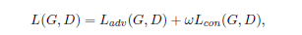
LOSS FUNCTIONS
The loss function 𝐿(𝐺,𝐷) in CartoonGAN combines two components:
Adversarial Loss 𝐿adv(𝐺,𝐷): Guides the generator G to transform input images into the cartoon manifold.
Content Loss 𝐿con(𝐺,𝐷):Ensures the semantic content from the input photo is preserved in the generated cartoon image.
Defined as:
Where ω controls the balance between content preservation and stylization
(set to 𝜔=10 in experiments).

Slide 13
LOSS FUNCTIONS - Adversarial Loss
Adversarial Loss 𝐿adv(𝐺,𝐷):
Encourages the generator G to produce outputs that resemble real cartoon images.
To address the challenge of clear edge reproduction (critical for cartoon images), a set of cartoon-like images without clear edges 𝑆data(𝑒) is created by:
Detecting edges using the Canny edge detector.
Dilating the edge regions.
Applying Gaussian smoothing on these regions.
The discriminator D learns to:
Recognize real cartoon images 𝑆data(𝑐).
Differentiate between cartoon-like images without edges 𝑆data(𝑒)) and generated images 𝐺(𝑝𝑘)).

Slide 14
LOSS FUNCTIONS
Figure 2: By removing clear edges in a cartoon image ci ∈ Sdata(c), we generate a corresponding image ei ∈ Sdata(e).

Slide 15
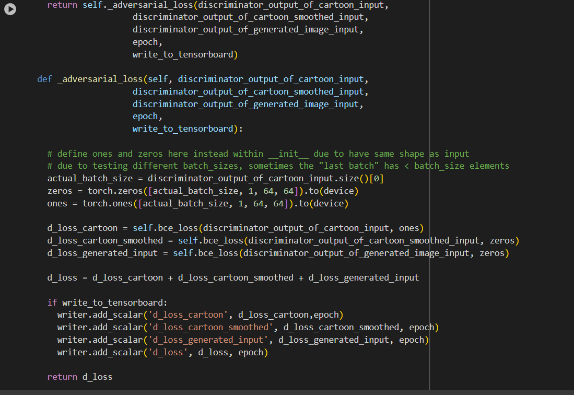
LOSS FUNCTIONS - Adversarial Loss

Slide 16
LOSS FUNCTIONS - Content Loss
Content Loss 𝐿con(𝐺,𝐷):
Ensures the preservation of semantic content between the input photo and the generated cartoon image.
Uses high-level feature maps from a pre-trained VGG network (layer ‘conv4_4’) to measure content similarity.
Employs ℓ 1​ -norm regularization instead of ℓ2​ -norm to handle the distinct characteristics of cartoon images (clear edges and smooth shading).
Defined as:

Slide 17
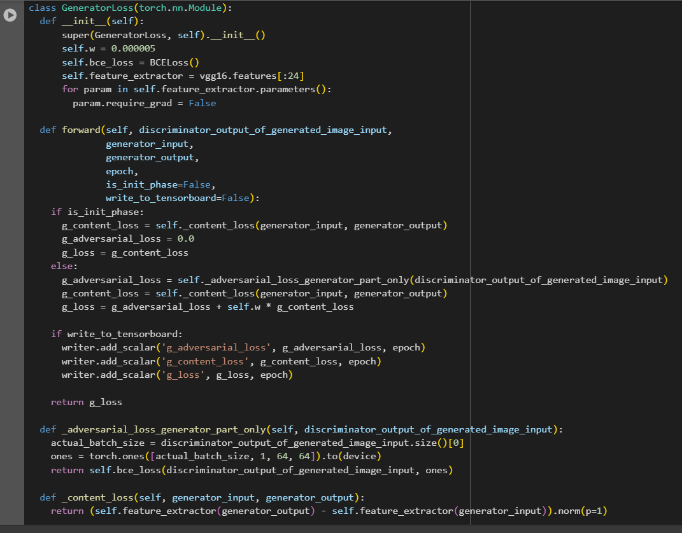
LOSS FUNCTIONS - Content Loss

Slide 18
INITIALIZATION PHASE
Challenge:
Due to the nonlinear nature of GAN models, random initialization often leads to suboptimal local minima during optimization.
Solution: Introduce a new initialization phase to improve convergence.
Goal of Generator Network (G): Transform input photos into cartoon style while preserving semantic content.

Slide 19
INITIALIZATION PHASE
4. Initialization Phase:
- Begin adversarial learning with a generator that only reconstructs the content of the input image. - Pre-train the generator network G using only the semantic content loss 𝐿con(𝐺,𝐷).
- Example: After 10 epochs, the reconstructed image already produces reasonable results.
Figure 4. For an original photo (a), the image (b) is the result after the initialization phase. See the main text for details.

Slide 20
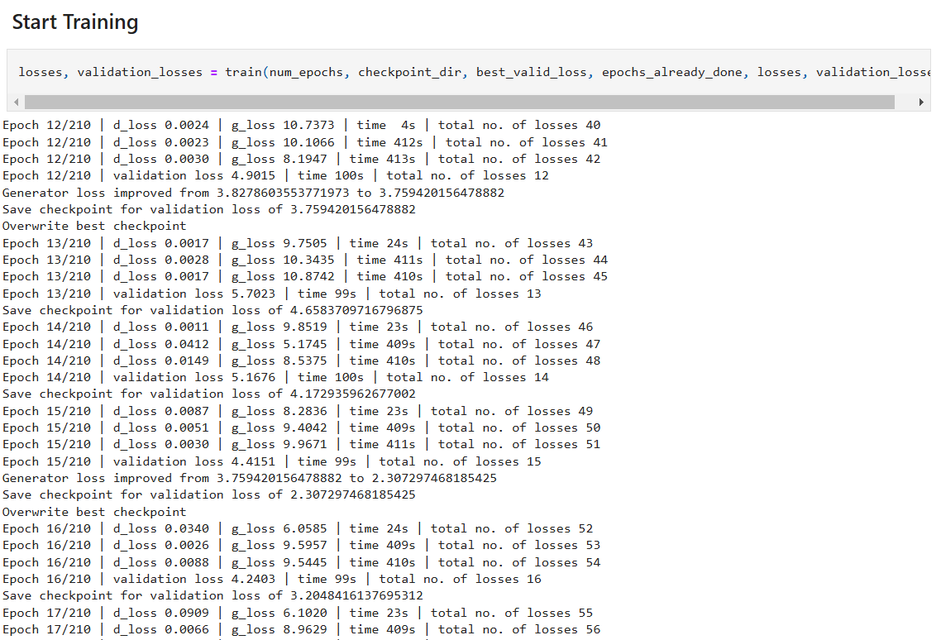
TRAINING
Generator loss improved so the ability of generating cartoon images increased

Slide 21
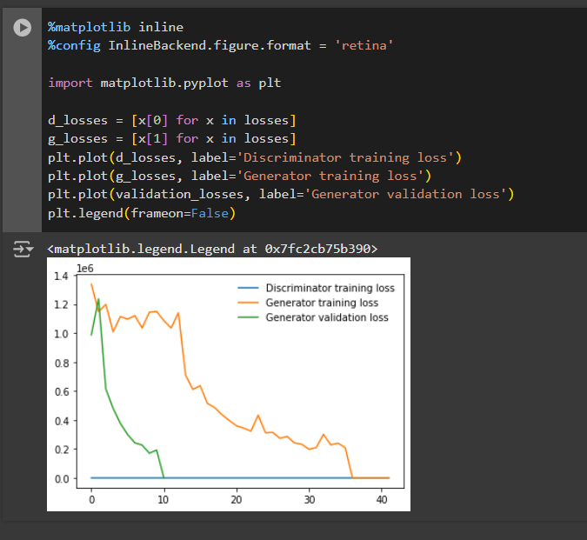
TRAINING

Slide 22
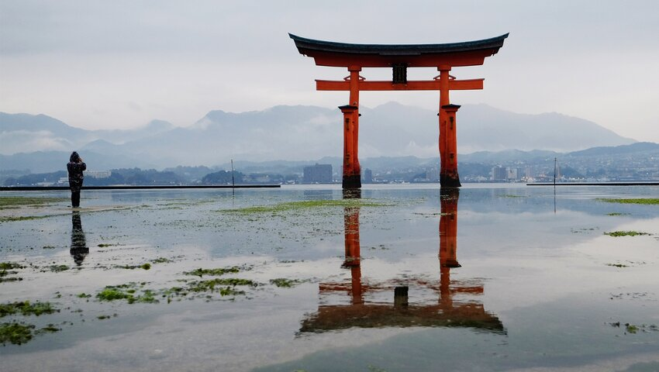
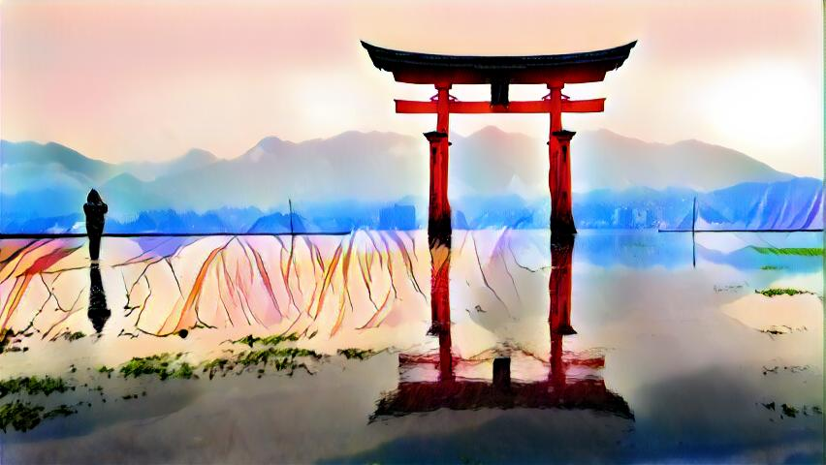
RESULT
In this paper we proposed CartoonGAN, a Generative Adversarial Network to transform real-world photos to high-quality cartoon style images.
Figure 5. Result

Slide 23
FUTURE WORK
1. Investigating how to exploit local facial features to improve cartoon stylization for human faces.
2. Adding sequential constraints to the training process to extend our method to handling videos.

Slide 24
REFERENCE
[1] P. L. Rosin and J. Collomosse, Image and Video-Based Artistic Stylisation. Springer, 2013.
[2] L. Gatys, A. Ecker, and M. Bethge, “Image style transfer using convolutional neural networks,” in
IEEE Conference on Computer Vision and Pattern Recognition (CVPR), 2016, pp. 2414–2423.
[3] J.-Y. Zhu, T. Park, P. Isola, and A. A. Efros, “Unpaired image-toimage translation using cycleconsistent
adversarial networks,” in International Conference on Computer Vision, 2017.
[4] M. Liu, T. Breuel, and J. Kautz, “Unsupervised image-to-image translation networks,” in Advances
in Neural Information Processing Systems, 2017, pp. 700–708.
[5] X. Huang, M. Liu, S. J. Belongie, and J. Kautz, “Multimodal unsupervised image-to-image translation,”
in European Conference on Computer Vision (ECCV), 2018, pp. 179–196.
[6] A. Anoosheh, E. Agustsson, R. Timofte, and L. V. Gool, “Combogan: Unrestrained scalability
for image domain translation,” in IEEE Conference on Computer Vision and Pattern Recognition
Workshops, 2018, pp. 783–790.

Slide 25
THANK YOU !

